Slide 1
EAST GRADE Course 2019: GRADE Overview
Bryce Robinson MD, MS, FACS, FCCM
Associate Professor of Surgery
Associate Medical Director, Critical Care
Harborview Medical Center
Department of Surgery
University of Washington
brobinso@uw.edu @traumabryce

Slide 2
No Disclosures

Slide 3
Learning Objectives
Understand the shortcomings of older practice management guideline (PMG) methodologies
Understand the basic work flow of GRADE methodology

Slide 4
What are PMGs?
Practice management guidelines (PMGs) are statements that include recommendations intended to optimize patient care that are informed by a systematic review of the evidence and an assessment of the benefits and harms of alternative care options.
Institute of Medicine, Clinical Practice Guidelines We Can Trust, 2011

Slide 5
Things used to be a lot easier….
To write a PMG, pre-2012
Form a group of like personalities and specialties
All encompassing PMG for a large topic
Create many, broad questions
ex) When should we remove cervical collars?
Review Pubmed
Give broad recommendations
ex) Cervical collars should be removed as soon as feasible after trauma

Slide 6
The Hierarchy of Literature Quality
Clinical Observations
Available Data
Case-Control Studies
Cohort Studies
Randomized Trials

Slide 7
Literature Quality = Recommendation Strength
Article Classification (I, II III):
Class I: “Prospective, randomized clinical trial”
Class II: “Clinical studies in which data were collected prospectively or retrospective analyses based on clearly reliable data
Class III: “Studies based on retrospectively collected data”

Slide 8
Literature Quality = Recommendation Strength
Recommendations classification (1,2,3):
Level 1: The recommendation is convincingly justifiable based on the available scientific data.
Usually based on high quality class I data or strong class II data
Level 2: The recommendation is reasonably justified by the data and strongly support by expert opinion.
Usually supported by class II data or a preponderance of class III data
Level 3: The recommendation is supported by available data but adequate scientific evidence is lacking. Supported by class III data.
This type of recommendation is useful for education purposes.
Interim Manual for Clinical Practice Guideline Development. Rockville, Md: Agency for Health Care Policy and Research; May 1991.

Slide 9
Literature Quality = Recommendation Strength
Class I Data
Level I Rec
“Strong”
Class II Data
Level II Rec
“Preponderance”
Class III Data
Level III Rec

Slide 10
Problems with the Old Way
No widespread, systematic approach
No transparency
How confident/certain are authors that the true effect lies close to the available estimate?
What’s expert opinion (bias)?
Are the authors “reaching” with recommendations?
No accounting for patient preferences, risk/reward of the therapy, charges…
Long PMGs

Slide 11
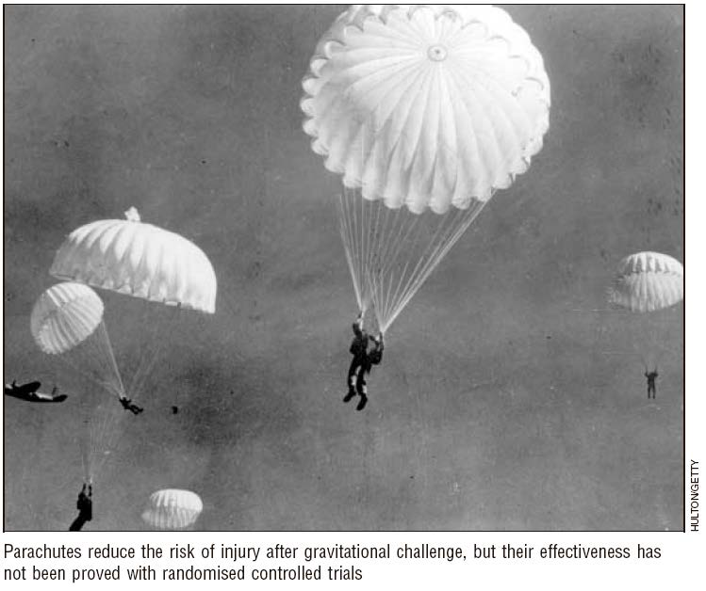
The Big Issue with Older Methods
“WEAK” EVIDENCE $≠$ WEAK RECOMMENDATION
BMJ 2003; 327: 1459-61

Slide 12
Goals of a High Quality PMG
From the Institute of Medicine (2011):
Based on a systematic review of existing evidence
Developed by a knowledgeable, multidisciplinary panel of experts
Considers important patient subgroups and patient preferences
Based on an explicit and transparent process that minimizes distortions, biases, and COI
Provides a clear explanation between care options and outcomes and provides ratings of both evidence quality and strength of recommendations
It is revised as appropriate when new information warrants modification
Institute of Medicine, Clinical Practice Guidelines We Can Trust, 2011

Slide 13
GRADE Methodology
GRADE Methodology is:
Grading of
Recommendation,
Assessment
Development
Evaluation

Slide 14
Other GRADE Groups
>100 organizations from 19 countries

Slide 15
Goal of GRADE Methodology
A method to assess the evidence
Evaluation of the totality of the literature
Expressing the quality of literature
Avoidance of expert opinion
Focus on transparency
Distinction between quality of evidence and strength of recommendation
Actionable statements from the authors

Slide 16
Framing the Right Question
The first action of the writing group
Can only write a PMG if literature exists for your questions
PMGs synthesize literature, not create it
No points for great questions, only for those that can be answered
No literature = No recommendation = No PMG

Slide 17
PICO Questions
GRADE methodology starts with PIC(O) questions
P: Population
I: Intervention
C: Comparison
O: Outcomes
EAST PMGs, try to stick to 2-4 questions
With multiple outcomes

Slide 18
What About Outcomes?
Include all possible outcomes at first
Teams make a large list and then vote
Rank of the outcomes, 1-9
7-9: Critical and will be included
4-6: Important but you may not have time (room)
1-3: Less important, are included

Slide 19
What About Outcomes?
Critical
Mortality
Length of Stay
Important
Patients perception of pain
P,I,C
Readmission
Weak
Wound complication
Cost

Slide 20
Example of Outcome Determination
Patel M et al., J Trauma Acute Care Surg. 2015;78:430-441.

Slide 21
A Bad Question
“Should splenic angioembolization be
performed over splenectomy?”

Slide 22
A Good PICO Question
Population, Intervention, Comparator, Outcome(s)
“In adult patients with blunt splenic trauma managed non-operatively (P), should angioembolization (I) be performed compared to no angioembolization (C) to improve splenic preservation (O)?”

Slide 23
PICOS and the Literature
For the reader, the PICOs will determine if this PMG aligns to patient practice
For the writer, the questions guide the literature search
What medical subject headings (MeSH) terms to use
Which database to search (good PMGs go beyond PubMed)
*Recruit a professional librarian
Kasotakis G et al., J Trauma Acute Care Surg. 2016;82:618-626.

Slide 24
Quantitative Synthesis for Effect Estimates
If able, PMGs will present meta-analyses if multiple studies exist with sufficiently similar “PICO type” architecture (similar conditions with similar subjects)
I² statistic =
% of variation across studies that is due to heterogeneity rather than chance.
>75% = high
<40% = low

Slide 25
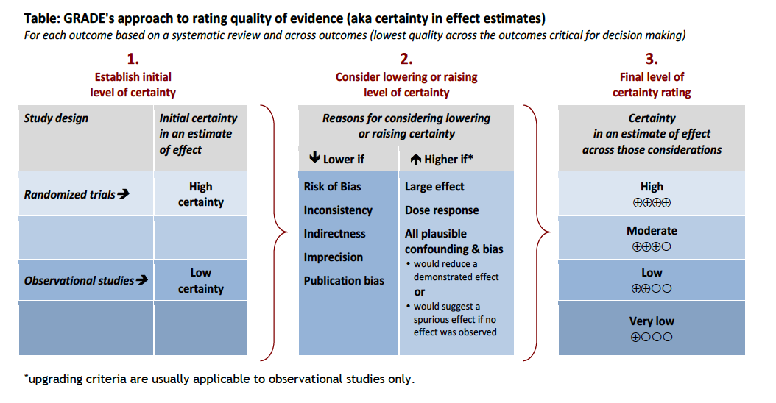
Qualitative Synthesis of the Literature Strength
How certain is the author group in an estimate of effect after reviewing the body of literature?
From the GRADE working group, Rebecca Morgan

Slide 26
Evidence Quality
High = very confident that the true effect lies close to that of the estimate of effect
Moderate = the true effect is likely to be close to the estimate of the effect
Low = confidence in the effect estimate is limited
Very low = very little confidence in the effect estimate

Slide 27
Lowering Certainty of the Effect
For each OUTCOME of the PICO
When to down-score the literature quality?
Risk of bias = randomization issues, concealed allocation, blinding, completeness of follow up…
Inconsistency = heterogeneity of the papers, unexplained different results between trials
Indirectness = different P,I and Os from the PICOs
Imprecision = low event rate, wide confidence intervals
Publication bias = the rare negative study, ‘gray’ literature

Slide 28
Raising the Certainty of the Effect
For each OUTCOME of the PICO
When to up-score the quality of the literature?
Mainly for observational trials
Large effect size (large risk ratios 0.5 or 2.0)
Dose-response exists
Plausible residual confounding; significant effect seen even in presence of major confounding

Slide 29
The Evidence Profile
After the quantitative (meta analysis) and qualitative grading of the literature quality, it’s time to make an evidence profile table.
An evidence profile is universal to GRADE methodology
The table represents:
A single PIC and many Os
All of the OUTCOMEs for that particular question
Provides the “quality assessment” (reason for altering certainty) for each OUTCOME
Provides a “summary of findings” (data) for each OUTCOME
The overall quality of the literature for the PIC(O) is based on the critical OUTCOME with the LOWEST quality

Slide 30
Example of an Evidence Profile
Fox N et al., J Trauma Acute Care Surg. 2015;78:136-146.

Slide 31
Putting It All Together for Each PICO Question
Overall Evidence Quality over all Outcomes
Feasibility, Equity, and Acceptability
RECOMMENDATION
Balance of Benefits vs. Harms
Patient’s Values and Preferences
Resource Use
Expert Opinion

Slide 32
The Strength of Recommendations
The “strength” of the recommendation reflects the extent to which we can be confident that the desirable effects of an intervention outweigh the undesirable effects.
Strong vs. weak recommendations

Slide 33
The Strength of Recommendations
A strong recommendation for:
Patients means: most and only a small proportion would not want the recommended therapy/intervention
Clinicians means: most patients should receive the recommended therapy/intervention
Policymakers means: that the recommendation can be evaluated as a new policy or performance measure
This is the new “standard of care”

Slide 34
The Strength of Recommendations
A weak (conditional) recommendation:
Used when the desirable effects of adherence to a recommendation are uncertain.
May be due to low-quality evidence (most common)
May be because the desirable and undesirable effects are closely balanced
May be due to a wide variation in patient preferences
May be due to a large resource need to implement the recommendation
“We conditionally recommend for/against” or “we suggest for/against”

Slide 35
The Strength of Recommendations
A weak recommendation for:
Patients means: most would want the recommended therapy/intervention but many would not
Clinicians means: that different choices with be appropriate for different patients
Policymakers means: that the recommendation will require more debate and involvement of stakeholders before policy can be determined

Slide 36
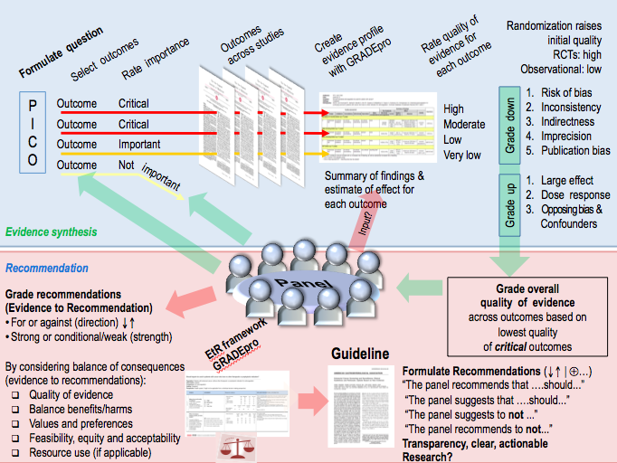
Summary of GRADE
From the GRADE working group, Shahnaz Sultan

Slide 37
QUESTIONS?

Slide 38
Learning Objectives
Understand the shortcomings of older practice management guideline (PMG) methodologies
Understand the basic work flow of GRADE methodology

Slide 39
Thank You

