Slide 1

EAST GRADE course 2019
Literature Search, Review and Abstraction/Quality of Evidence
Zachary Bauman, DO, MHA, FACOS, FACS
Rishsi Rattan, MD, FACS

Slide 2

Systematic Literature Search
Step 1: The Search
  Use your institution librarian
  At least 3 – 4 search engines
  Broad search terminology
  Make sure to keep track of how your doing this
    Will need a PRISMA flow diagram
Notes:
Review of references of manuscripts
Seminal/high-impact/highly-cited works

Slide 3
Systematic Literature Search
Step 2: Title and Abstract Screen
  Allow 2-3 weeks
  Put in Excel spreadsheet
  Remove duplicates
  ?? English language ??
  Assign each abstract to TWO members for review
  Inclusion vs exclusion (if excluded → ??why??)

Slide 4
Abstract Inclusion/Exclusion
Inclusion:
  Similar patient population
  Intervention being compared
  All literature is fair game
    You will have to rate it
Exclusion:
1. Study lacks intervention
or comparator groups
2. Not a primary study
3. Case report
4. Animal study
5. Not in English
6. Other

Slide 5
Reviewers | First Author | Year of Pub | Title | PMID | Abstract | Include | Reason for Exclusion
 |  |  |  |  |  | 1: Yes, 0: No | 1: No Int/Comp groups 2: Not primary study 3: Case report 4. Animal study 5. Not in English 6. Other
AG, DC
AG, GK
GK, DC
Notes:
East Task Force leaders and librarians have Excel templates you can use so you don’t have to create your own.

Slide 6
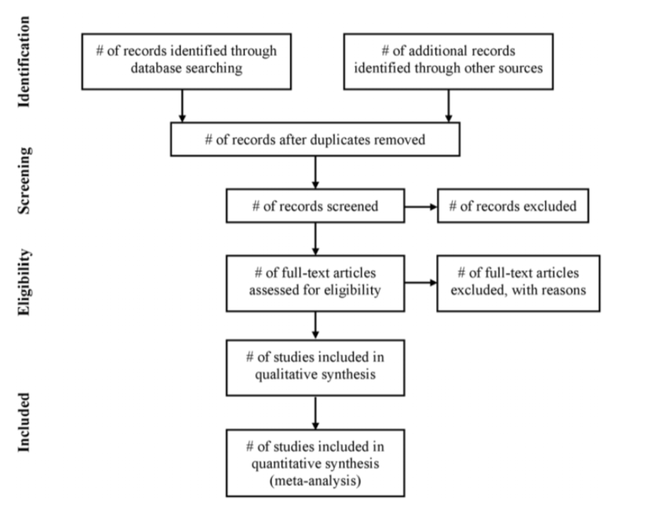
PRISMA Flow Diagram

Slide 7
Full Text Review and Data Extraction
Step 1: Retrieval
  Download all full manuscripts for ‘included’ abstracts
  Put in online folder for all team members to access
Step 2: Repeat review process for full manuscripts
  Reviewers need to match
  Increase efficiency by combining with data abstraction
  Allow 3-4 weeks. Keep everyone on track!!
  Covidence.org
Notes:
- Reference manager and cloud drive keeping track of everything and helping with efficiency

Slide 8
Reviewers | First Author | Year of Pub | Title | Patient population | Study Design | Include | Reason for Exclusion
 |  |  |  | 1. Surgery 2. Trauma 3. SICU 4. Medicine 5. Peds | 1. PRCT 2. Retrosp 3. Observ. | 1: Yes, 0: No | 1: No Int/Comp groups 2: Not primary study 3: Case report 4. Animal study 5. Not in English 6. Other
AG, DC
AG, GK
GK, DC

Slide 9
Intervention Sample Size | Intervention– Continuous Outcome 1 mean | Intervention– Continuous Outcome 1 SD | Comparison Sample Size | Comparison–Continuous Outcome 1 mean | Comparison– Continuous Outcome 1 SD | p-value

Slide 10
Intervention Sample Size | Intervention– Number with Outcome 1 | Intervention– Number without Outcome 1 | Comparison Sample Size | Comparison- Number with Outcome 1 | Comparison– Number without Outcome 1 | p-value

Slide 11
Example
  Title: Preperitoneal Packing for Pelvic Fracture Hemorrhage
  PICO 1:
  In blunt trauma patients who are unstable due to their pelvic fractures (pelvic binder is on), should initial preperitoneal packing vs. initial angiography be performed to decrease transfusion requirements and mortality?
Notes:
Review of references of manuscripts
Seminal/high-impact/highly-cited works

Slide 12
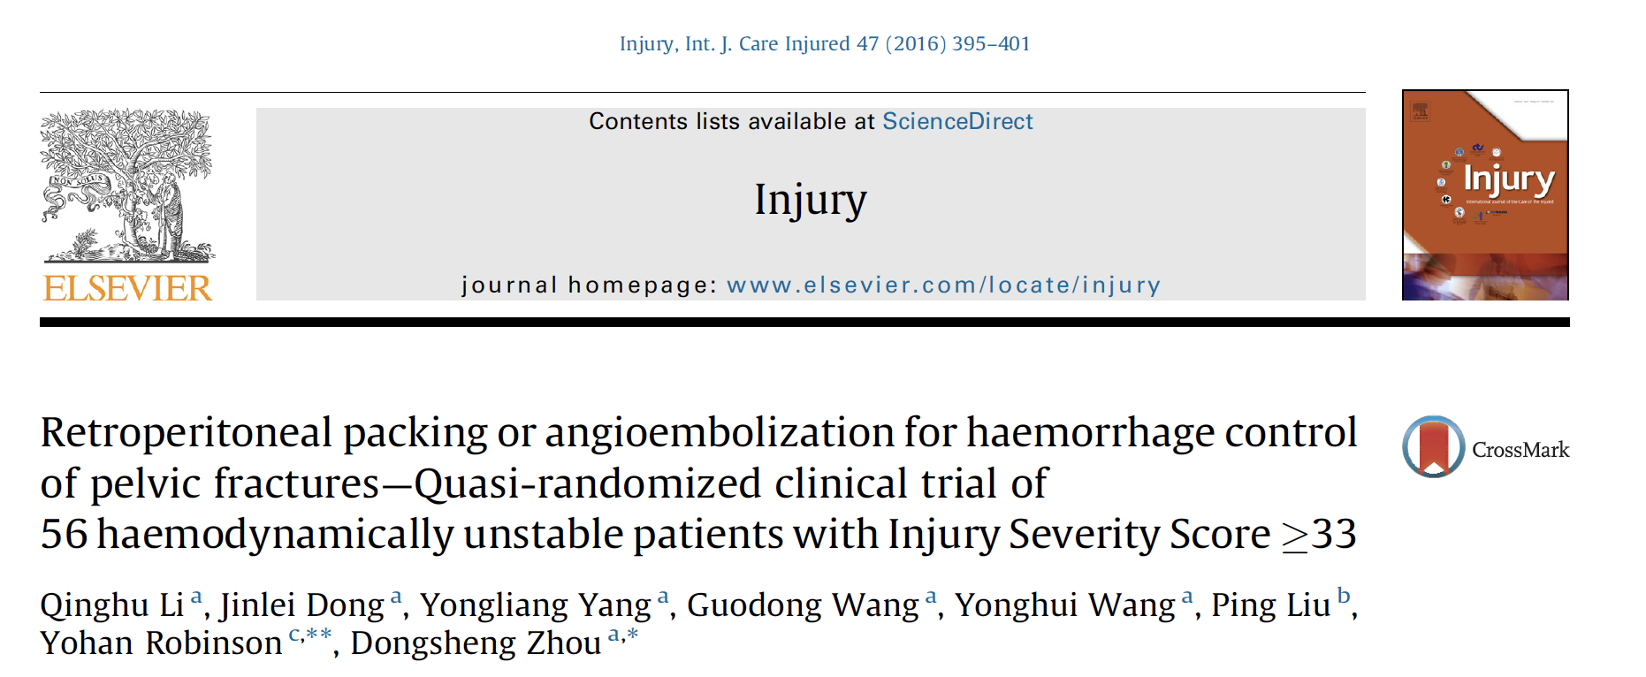
Example
Notes:
- Reference manager and cloud drive keeping track of everything and helping with efficiency

Slide 13
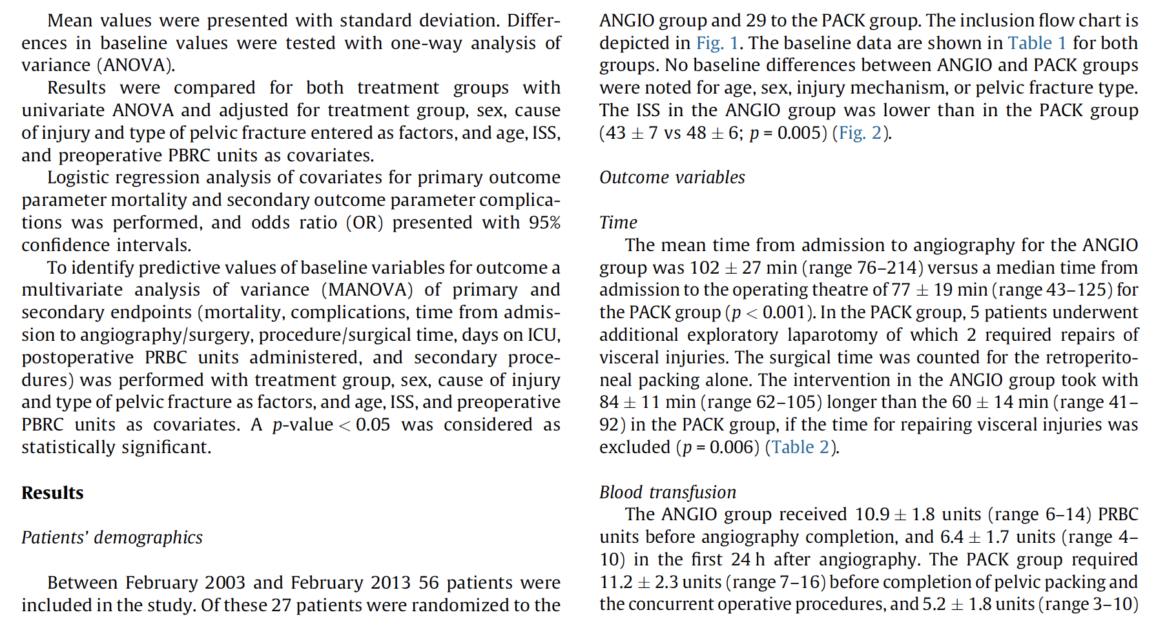
Example

Slide 14
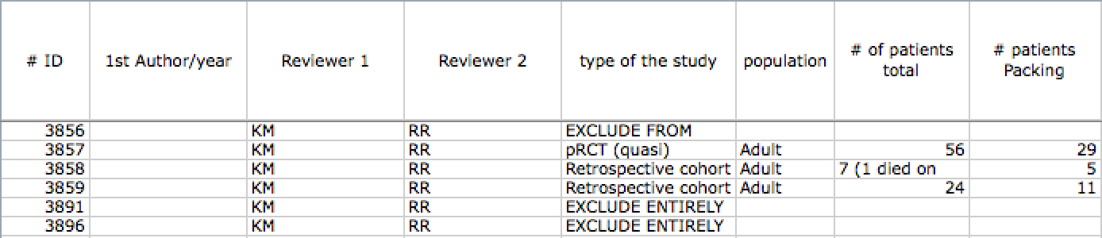
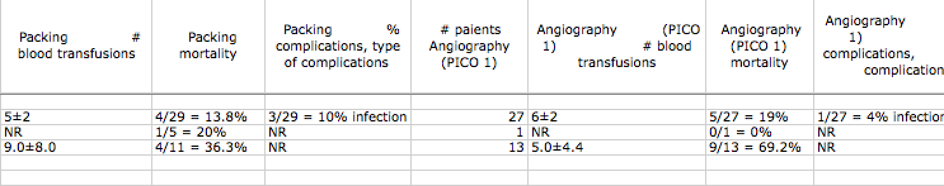

Slide 15
Example
Notes:
- Reference manager and cloud drive keeping track of everything and helping with efficiency

Slide 17
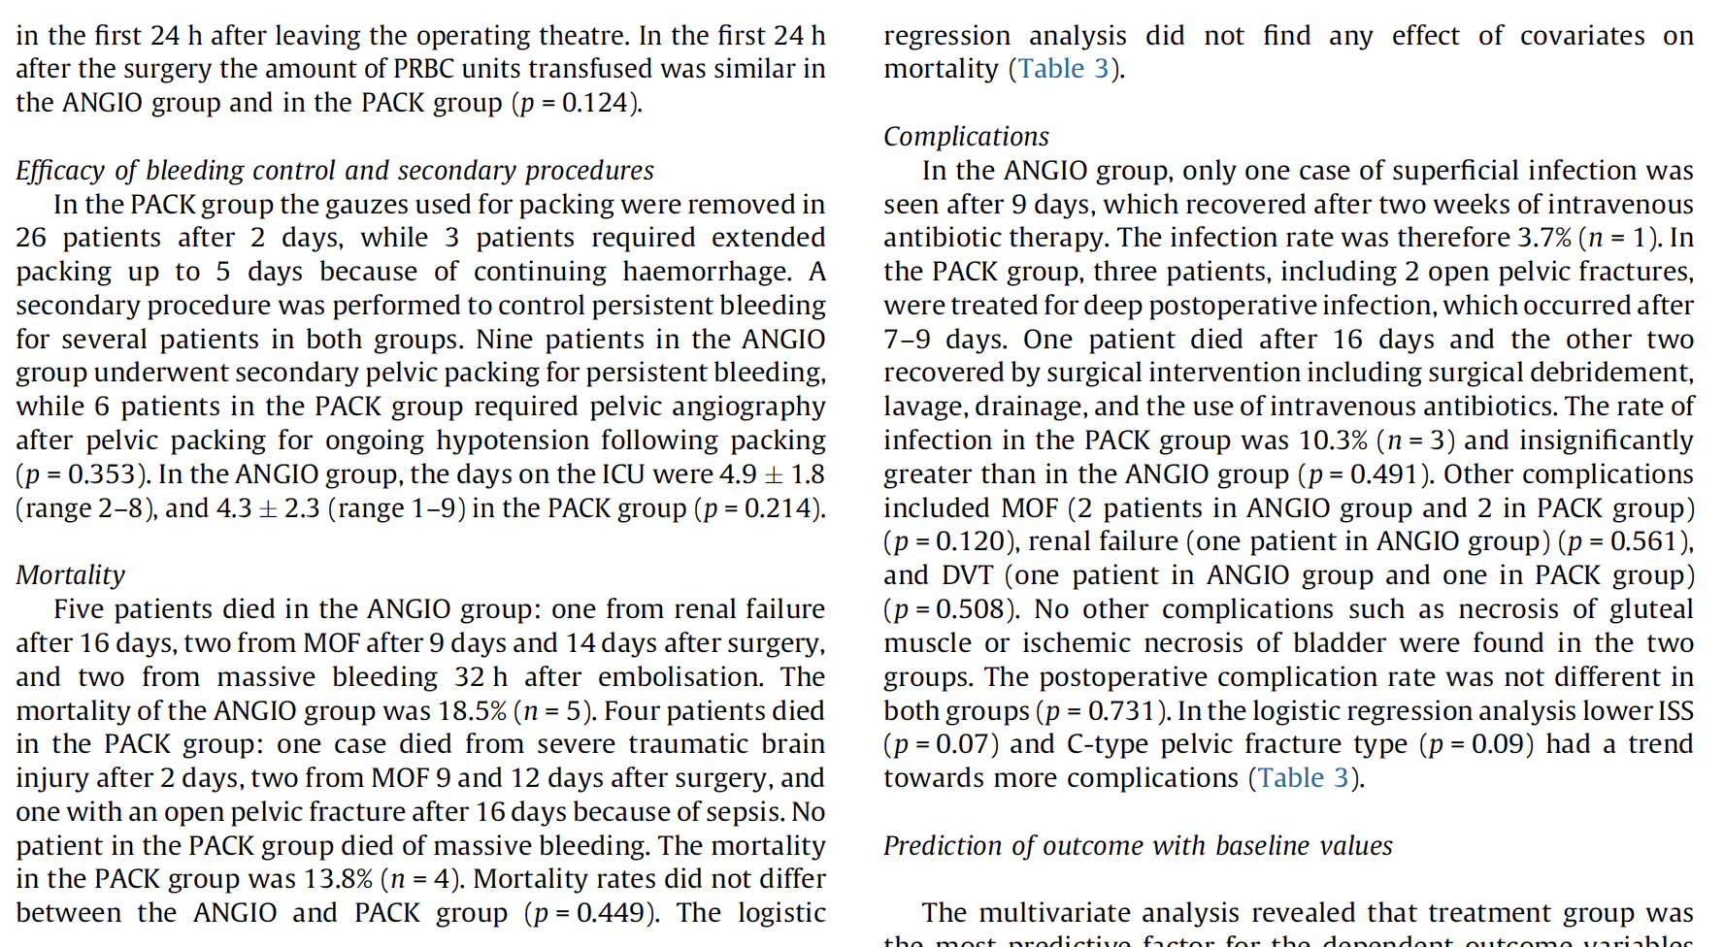
Example
Notes:
- Reference manager and cloud drive keeping track of everything and helping with efficiency

Slide 19
Example
Notes:
- Reference manager and cloud drive keeping track of everything and helping with efficiency

Slide 21
Risk of bias assessment
Critical in determining validity
One of several assessments of quality of evidence
Cochrane tool recommended:
  riskofbias.info

Slide 24
Questions??

