Slide 1

EAST GRADE course 2019
Introduction to Meta-Analysis
Jaswin Sawhney
Maine Medical Center
Portland, Maine

Slide 2

Introduction to Meta-Analysis
What is a systematic review?
A systematic review is a research methodology that tries to identify, select, appraise, and synthesize all research evidence relevant to a specific research question

Slide 3
Introduction to Meta-Analysis
What is a meta-analysis?
A meta-analysis is a statistical technique for combining data from multiple independent, sufficiently comparable studies to assess outcomes related to a specific intervention

Slide 4
Introduction to Meta-Analysis
Systematic Review
Meta-Analysis
Notes:
Systematic review without meta-analysis when cannot combine data from different studies
Meta-analysis without systematic when all studies are not included for review

Slide 5
Introduction to Meta-Analysis
Why Perform a Meta-Analysis?
  Increase power (precision) of estimates
  Quantify effect sizes and their uncertainty
  Improve applicability
  Assess consistency of results
  Answer questions not posed by individual studies (factors that differ across studies)
  Settle controversies from conflicting studies or generate new hypotheses

Slide 6
Introduction to Meta-Analysis
Not all systematic reviews will yield a meta-analysis since often, the studies are not amenable to combining if they are too heterogeneous
However, every meta-analysis should always follow a rigorous systematic review
Studies must be sufficiently similar regarding populations, interventions, comparisons, outcomes, and timing (PICOT) to be pooled for meta-analysis

Slide 8
Notes:
Go over terms

Slide 9
Random vs Fixed effect models
Random effects models consider both within-study and between-study variability and assumes that studies included in the meta-analysis are a random sample from all possible studies.
  Generally the preferred model for meta-analysis
Fixed effects models consider only within-study variability which assumes that studies use identical methods, patients, and measurements.

Slide 10
Considerations for Meta-Analysis Results
Magnitude of effect – The farther from the null line, the greater the magnitude of effect of an intervention. The overall effect estimate may be skewed by studies with outlying point estimates
Confidence Interval – A confidence interval that crosses 1, visually indicated by the null line, indicates no statistically significant difference
Weighting – Meta-analyses are weighted by the sample size of each included study, so a large study will provide greater weight to the overall estimate than smaller studies. The overall effect estimate may be skewed by studies with atypical sample sizes.
Heterogeneity (I squared ) – A measure of inconsistency across included studies ranging from 0-100% where lower numbers indicate less heterogeneity (i.e. more consistent)

Slide 11
Considerations for Meta-Analysis Results
Sensitivity Analyses – A sensitivity analysis selectively removes studies that may artificially influence the results.
Examples of studies that may be removed for sensitivity analysis include incomparable interventions (e.g. a study of diuretics that includes HCTZ and furosemide when all other studies include only HCTZ), different demographic characteristics of patients, poor quality studies, temporality (i.e. studies published years ago may not be applicable to current practice).

Slide 12
Considerations for Meta-Analysis Results
Subgroup analyses – Stratified analysis of studies exploring the same outcome of interest.
Subgroup analyses may be done by patient demographics (e.g. sex, race), interventions (e.g. HCTZ only, HCTZ or furosemide, furosemide only), or timing (e.g. surgery within 6 hours, surgery within 12 hours, etc).
Subgroup analyses to be performed should be defined beforehand in the protocol and be limited in numbers to avoid spurious findings.

Slide 13
Notes:
Go over terms

Slide 14
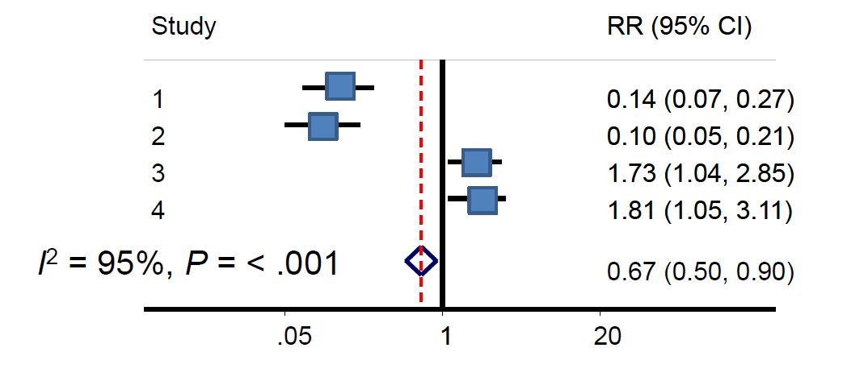
Heterogeneity

Slide 16
Introduction to Meta-Analysis- Summary
A meta-analysis is a statistical technique for combining data from multiple independent, sufficiently comparable studies to assess outcomes related to a specific intervention
Outcomes are generally reported as odds ratio and relative risk
Results will be shown on a forest plot illustrating concepts of magnitude of effect, confidence interval, weighting, and heterogeneity

