Slide 1

Introduction to Just Culture
Safe
Patient &
Provider-
centered
Timely
Efficient
Effective
Equitable
Eastern Association for the Surgery of Trauma
Advancing Science, Fostering Relationships, and Building Careers

Slide 2
Foundation of Quality:
High Reliability Organizations and Just Culture Philosophy
Safe
Patient &
Provider-
centered
Timely
Efficient
Effective
Melissa Boltz, DO, MBA, FACS
Melissa Warta, MD, FACS
Equitable
Eastern Association for the Surgery of Trauma
Advancing Science, Fostering Relationships, and Building Careers

Slide 3

Annie’s Story: How a System’s Approach Can Change Safety Culture
Video Link: https://youtu.be/zeldVu-3DpM
Safe
Patient &
Provider-
centered
Timely
Efficient
Effective
Equitable
Eastern Association for the Surgery of Trauma
Advancing Science, Fostering Relationships, and Building Careers

Slide 4
What is High Reliability?
Concept based on study of industries maintaining high levels of safety over long periods of time
Consistent EXCELLENCE
Healthcare = near-zero rates of failures for critical quality processes
Safe
Patient &
Provider-
centered
Timely
Efficient
Effective
Equitable
Eastern Association for the Surgery of Trauma
Advancing Science, Fostering Relationships, and Building Careers
Notes:
High reliability is a concept that comes from the study of industries that have maintained very high levels of safety over very long periods of time. Basically what it means is consistent excellence. In the healthcare industry that equates to establishing near-zero rates of failures for critical quality processes and making sure that they stay at that level of performance across all services.

Slide 5






High Reliability Principles
Safety
Sensitivity to Operations
Preoccupation with Failure
Quality
Efficiency
H.R.O.
Reluctance to Simplify
Deference to Expertise
Commitment to Resilience
Eastern Association for the Surgery of Trauma
Advancing Science, Fostering Relationships, and Building Careers
Notes:
Brain signifies the “collective mindfulness” culture—all the workers in the organization contribute
Multiple Pieces/Components to a system to work→Have a heightened awaresness of the current state of relevanct systems/processes
Snowflake/Fractals→ over simplifying is counter-productive. Accept that the work is complex and there is potential to fail in new & unexpected ways
Olympic Rings→the Olympians have to demonstrate resilience and prioritize training and condition themselves for the unexpected system failures. Priority emergency training for unlikely but system failures→PREPARE your teams
Deference to Expertise→value the insight of those with the most knowledge-not the ones with the most seniority
Sky Divers—Have multitude of reasons to ensure parachute doesn't fail→view the near miss as an opportunity instead of a success

Slide 6




High Reliability Organizations
Safe
Patient &
Provider-
centered
Timely
Efficient
Effective
Equitable
Notes:
What do 3 of these have in common? Three of these organizations rarely, if ever, have significant accidents. They are all considered high reliability organizations. The odd one out is healthcare. In healthcare routine safety processes fail routinely. But, why? It’s not that we don’t care is because healthcare is a phenomenally complex and dangerous industry and it depends on human beings.
But could healthcare become highly reliable as well – what would hospitals have to do differently to achieve this goal?

Slide 7
What Makes an Organization Highly Reliable?
Leadership
Effective safety culture
Robust process improvement methods
Safe
Patient &
Provider-
centered
Timely
Efficient
Effective
Equitable
Eastern Association for the Surgery of Trauma
Advancing Science, Fostering Relationships, and Building Careers
Notes:
For an organization to become highly reliable it needs strong leadership commitment to drive an effective safety culture, and adopt robust process improvement methods embedding those safety principles, encouraging employees to report problems when they are in their early phases. In other words organizations must follow a just culture philosophy.

Slide 8
Just Culture: Philosophy
Recognizes that individuals should not be held accountable for system failings of which they have no control
Many errors represent predictable interactions between human operators and systems in which they work
Competent professionals develop unhealthy norms
Zero tolerance for reckless behavior
Safe
Patient &
Provider-
centered
Timely
Efficient
Effective
Equitable
Eastern Association for the Surgery of Trauma
Advancing Science, Fostering Relationships, and Building Careers
Notes:
The Just Culture philosophy is built upon four foundational elements that allow for the differentiation of innocent from blameworthy mistakes:
1. Individual practitioners should not be held accountable for system failings over which they have no control.
2. Just Culture recognizes that many errors represent predictable interactions between human operators and the systems in which they work and recognizes that competent professionals make mistakes.
3. Just Culture acknowledges that even competent professionals will develop unhealthy norms (shortcuts, workarounds, and “routine rule violations”).
4. A Just Culture has zero tolerance for reckless behavior.

Slide 9
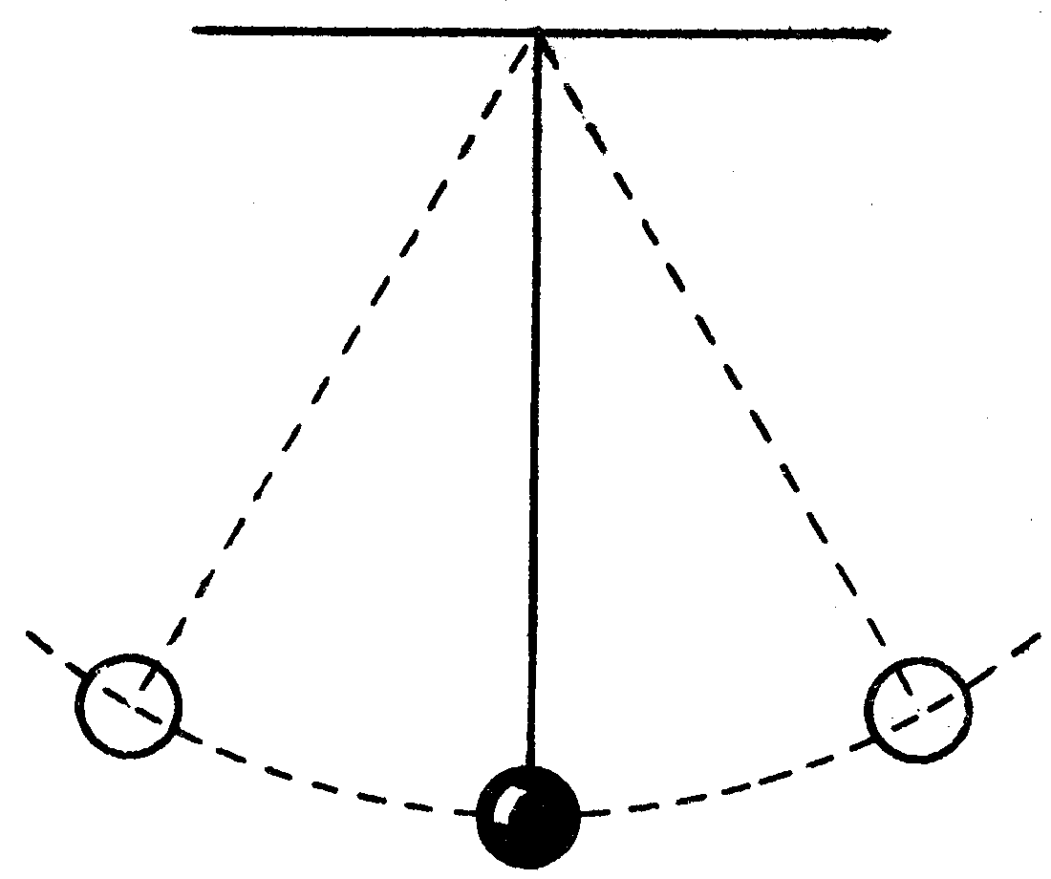
Just Culture: A Balanced Approach
Fair or Just Culture
Culture of Blame
Errors are punished
Offenders are removed from system
Only errors that can’t be covered up are reported
Errors continue because system cannot learn from mistakes
Blame Free Culture
Errors are forgiven
Offenders remain in system
Errors reporting is high
Errors continue because there is no accountability for performance
Patient &
Provider-
centered
Efficient
Effective
Equitable
Eastern Association for the Surgery of Trauma
Advancing Science, Fostering Relationships, and Building Careers
Notes:
Just culture represents a balanced approach to quality and safety. Neither a culture of blame or a blame free culture will prevent errors.
In a culture of blame, those who make errors are punished or removed from the system but errors continue because reporting is inhibited and the system cannot learn from its mistakes.
In a blame free culture, reporting may be high but errors continue because there is no accountability for adhering to rules or policies.
A fair or just culture creates accountability while encouraging error reporting.

Slide 10
What is a Safety Culture?
Managing the Risks of Organizational Accidents
  James T. Reason, 1997
Good safety culture is composed of 5 elements
Safe
Patient &
Provider-
centered
Timely
Efficient
Effective
Equitable
Eastern Association for the Surgery of Trauma
Advancing Science, Fostering Relationships, and Building Careers
Notes:
Now that we know the fundamentals of what a Just Culture is we have to ask how does it fit into the overall culture of safety?
In 1997, James Reason wrote a book called Managing the Risks of Organizational Accidents.
Does anyone know who this person is? He’s the guy that developed the Swiss Cheese model used in risk analysis and management to describe how accidents occur.
In his book he describes that a good safety culture is comprised of five elements.

Slide 11
Safe
Patient &
Provider-
centered
Timely
Efficient
Effective
Equitable
Eastern Association for the Surgery of Trauma
Advancing Science, Fostering Relationships, and Building Careers
Notes:
Those who manage and operate a system have to be informed about the current knowledge of the human, technical, organizational, and environmental factors that determine the safety of the system as a whole.
Of these elements, Just Culture is critical and lays the foundation for the other elements. It is defined as an atmosphere of trust in which people are encouraged or even rewarded for providing essential safety-related information.
However, there is also a clear line between acceptable and unacceptable behavior.
It is important to also realize that it is not an absence of disciplinary action. It actually ensures that disciplinary action is carried out consistently and fairly for unacceptable behaviors.
With that we will turn over the talk to ____ to discuss a few tools on how to analyze safety issues using the just culture philosophy.

Slide 12
Overview of Just Culture Tools
Safe
Patient &
Provider-
centered
Timely
Carlos Palacio, MD, FACS
George Koenig, DO, MS
Efficient
Effective
Equitable
Eastern Association for the Surgery of Trauma
Advancing Science, Fostering Relationships, and Building Careers

Slide 13
THE FIVE BEHAVIORS
Conduct that was not intended: a slip or a mistake
ACCEPT
Conduct that is intended, but risk is not recognized
Propensity to drift
COACH
Risk of harm is seen to be significant, but person chooses to disregard the risk
DISCIPLINARY ACTION
Knowingly causing harm
“My life, my rules”
DISCIPLINARY ACTION
A purpose to cause harm
DISCIPLINARY ACTION
Human Error
At-Risk Behavior
Reckless
Knowledge
Purpose
Eastern Association for the Surgery of Trauma
Advancing Science, Fostering Relationships, and Building Careers
www.east.org
Notes:
There are five behaviors in the just culture model . They are used in the justice system to determine if an appropriate sanction is determine. These are precise terms with each of these behaviors having an underlying cause worthy of investigation.
Investigating the cause behind the behavior minimizes the risk of future harm.

Slide 14
THE FIVE BEHAVIORS
Conduct that was not intended: a slip or a mistake
ACCEPT
Conduct that is intended, but risk is not recognized
Propensity to drift
COACH
Risk of harm is seen to be significant, but person chooses to disregard the risk
DISCIPLINARY ACTION
Knowingly causing harm
“My life, my rules”
DISCIPLINARY ACTION
A purpose to cause harm
DISCIPLINARY ACTION
Human Error
At-Risk Behavior
Reckless
Knowledge
Purpose
Eastern Association for the Surgery of Trauma
Advancing Science, Fostering Relationships, and Building Careers
www.east.org
Notes:
The first of the five behaviors is Human error:
It’s a conduct that was not intended: Things I do I never intended to do
Human errors is to humans like craters are to the moon

Slide 15
THE FIVE BEHAVIORS
Conduct that was not intended: a slip or a mistake
ACCEPT
Conduct that is intended, but risk is not recognized
Propensity to drift
COACH
Risk of harm is seen to be significant, but person chooses to disregard the risk
DISCIPLINARY ACTION
Knowingly causing harm
“My life, my rules”
DISCIPLINARY ACTION
A purpose to cause harm
DISCIPLINARY ACTION
Human Error
At-Risk Behavior
Reckless
Knowledge
Purpose
Eastern Association for the Surgery of Trauma
Advancing Science, Fostering Relationships, and Building Careers
www.east.org
Notes:
The second behavior is At-Risk Behavior
Unlike human error, we choose the behavior
A nurse might not wash his or her hand going into a patients room with the belief that no infection will occur.
Think about all the risky things you do while driving that you will never do in front of the road test examiner.
Coaching is the preferred response to At-risk Behavior. Discuss the risk you see, that the employee doesn’t.
If the employee continues to make At risk Behavior after coaching, he or she will have a disciplinary sanction

Slide 16
THE FIVE BEHAVIORS
Conduct that was not intended: a slip or a mistake
ACCEPT
Conduct that is intended, but risk is not recognized
Propensity to drift
COACH
Risk of harm is seen to be significant, but person chooses to disregard the risk
DISCIPLINARY ACTION
Knowingly causing harm
“My life, my rules”
DISCIPLINARY ACTION
A purpose to cause harm
DISCIPLINARY ACTION
Human Error
At-Risk Behavior
Reckless
Knowledge
Purpose
Eastern Association for the Surgery of Trauma
Advancing Science, Fostering Relationships, and Building Careers
www.east.org
Notes:
The third behavior is Reckless Behavior
The choice of harm is significant and unjustifiable but the person chooses to disregards the risk
That voice inside our head sees the risk, knocks the door of our conscious brain, and tell us we are about to take an unreasonable risk.
We refer to this as “the Gamble”.
The limited goal of a Disciplinary action is Deterrence. You slow down when you see the police car.

Slide 17
THE FIVE BEHAVIORS
Conduct that was not intended: a slip or a mistake
ACCEPT
Conduct that is intended, but risk is not recognized
Propensity to drift
COACH
Risk of harm is seen to be significant, but person chooses to disregard the risk
DISCIPLINARY ACTION
Knowingly causing harm
“My life, my rules”
DISCIPLINARY ACTION
A purpose to cause harm
DISCIPLINARY ACTION
Human Error
At-Risk Behavior
Reckless
Knowledge
Purpose
Eastern Association for the Surgery of Trauma
Advancing Science, Fostering Relationships, and Building Careers
www.east.org
Notes:
The Fourth behavior is Knowledge
Knowing causing harm, is what we refer to as “me first”. We choose ourselves over others.
Sometimes harm is the right answer : The firefighter who trespasses to save a life.
Once again, Disciplinary action is the way to go.

Slide 18
THE FIVE BEHAVIORS
Conduct that was not intended: a slip or a mistake
ACCEPT
Conduct that is intended, but risk is not recognized
Propensity to drift
COACH
Risk of harm is seen to be significant, but person chooses to disregard the risk
DISCIPLINARY ACTION
Knowingly causing harm
“My life, my rules”
DISCIPLINARY ACTION
A purpose to cause harm
DISCIPLINARY ACTION
Human Error
At-Risk Behavior
Reckless
Knowledge
Purpose
Eastern Association for the Surgery of Trauma
Advancing Science, Fostering Relationships, and Building Careers
www.east.org
Notes:
The fifth behavior is the purpose to cause harm either physical, emotional or to property.

Slide 19
THE THREE DUTIES
Reliability Focused
“How to perform work”
See only 3 of the 5 behaviors
Human Error
At-Risk
Reckless
Mission Focused
Cannot see the 5 behaviors
“What to do”
Valued Focused
Societal
Organizational
Local
See all the 5 behaviors
“Do not do”
Duty to Follow procedural rules
Duty to produce Outcomes
Duty to Avoid Causing unjustifiable risk or Harm
Eastern Association for the Surgery of Trauma
Advancing Science, Fostering Relationships, and Building Careers
www.east.org
Notes:
There are three duties in the just culture model. Lets use the analogy of baking a cake to teach the three duties.
When we cook, we are following the recipe. Recipes represent the path, the “how to” to produce an outcome – A tasty chocolate cake.
When that recipe is a rule, it has become a procedural rule …

Slide 20
THE THREE DUTIES
Reliability Focused
“How to perform work”
See only 3 of the 5 behaviors
Human Error
At-Risk
Reckless
Mission Focused
Cannot see the 5 behaviors
“What to do”
Valued Focused
Societal
Organizational
Local
See all the 5 behaviors
“Do not do”
Duty to Follow procedural rules
Duty to produce Outcomes
Duty to Avoid Causing unjustifiable risk or Harm
Eastern Association for the Surgery of Trauma
Advancing Science, Fostering Relationships, and Building Careers
www.east.org
Notes:
When the recipe is a rule, it has become a procedural rule. The duty to follow a procedural rule is the duty to follow the recipe. “How to rule”.
This is also known as following the path.

Slide 21
THE THREE DUTIES
Reliability Focused
“How to perform work”
See only 3 of the 5 behaviors
Human Error
At-Risk
Reckless
Mission Focused
Cannot see the 5 behaviors
“What to do”
Valued Focused
Societal
Organizational
Local
See all the 5 behaviors
“Do not do”
Duty to Follow procedural rules
Duty to produce Outcomes
Duty to Avoid Causing unjustifiable risk or Harm
Eastern Association for the Surgery of Trauma
Advancing Science, Fostering Relationships, and Building Careers
www.east.org
Notes:
The duty to produce an outcome, is the “what to do”. The outcome is the cake.
Think of this was “What to do”. For the cake maker, it is to make cakes. The duty is not about conduct but about the result.

Slide 22
THE THREE DUTIES
Reliability Focused
“How to perform work”
See only 3 of the 5 behaviors
Human Error
At-Risk
Reckless
Mission Focused
Cannot see the 5 behaviors
“What to do”
Valued Focused
Societal
Organizational
Local
See all the 5 behaviors
“Do not do”
Duty to Follow procedural rules
Duty to produce Outcomes
Duty to Avoid Causing unjustifiable risk or Harm
Eastern Association for the Surgery of Trauma
Advancing Science, Fostering Relationships, and Building Careers
www.east.org
Notes:
The last of the three duties and the most important, is the duty to avoid causing unjustifiable risk or harm.
Picking up eggs from the floor to cook the cake.
These are the don’t do rules. These values exists at a societal, organizational, and local levels.

Slide 23
THE THREE DUTIES
Valued Focused
Societal
Organizational
Local
See all the 5 behaviors
“Do not do”
Reliability Focused
“How to perform work”
See only 3 of the 5 behaviors
Human Error
At-Risk
Reckless
Mission Focused
Cannot see the 5 behaviors
“What to do”
Duty to Avoid Causing unjustifiable risk or Harm
Duty to Follow procedural rules
Duty to produce Outcomes
THE FIVE BEHAVIORS
Conduct that was not intended: a slip or a mistake
ACCEPT
Conduct that is intended, but risk is not recognized
Propensity to drift
COACH
Risk of harm is seen to be significant, but person chooses to disregard the risk
DISCIPLINARY ACTION
Knowingly causing harm
“My life, my rules”
DISCIPLINARY ACTION
A purpose to cause harm
DISCIPLINARY ACTION
Human Error
At-Risk Behavior
Reckless
Knowledge
Purpose
Eastern Association for the Surgery of Trauma
Advancing Science, Fostering Relationships, and Building Careers
www.east.org
Notes:
In summary these are the three duties and five behaviors.

Slide 24
Eastern Association for the Surgery of Trauma
Advancing Science, Fostering Relationships, and Building Careers
Performance Management Decision Guide
Adapted from James Reason’s Decision Tree for Determining the Culpability of Unsafe Acts
Start
Deliberate Act Test
Incapacity Test
Compliance Test
Substitution Test
Did the individual intend the behavior/act?
Is there evidence of ill health, a medical condition, or substance abuse?
Did the individual depart from policies, procedures, protocols, or generally accepted performance standards?
Would individuals in the same profession and with comparable knowledge, skills, and experience act the same under similar circumstances?
No
No
No
Yes
Yes
Substance Abuse/other addiction
Ill health, medical condition, or mental health concern
Yes
No
Were the policies, procedures, protocols, or performance standards available, understandable, workable, and in routine use?
No
Yes
Yes
Yes
Did the individual act with malicious intent (i.e. to cause physical/mental harm or other damage)?
Was the individual aware of the ill health or medical condition?
Is there evidence that the individual chose to take an unacceptable risk OR has a trend in poor performance or decision making?
Were there any deficiencies in related training, experience, resources, or supervision?
No
Yes
No
Yes
Yes
No
Yes
No
Were there significant mitigating circumstances that justify the act in this case?
Yes
No
Malevolent or Willful Misconduct
Medical Condition OR Substance Abuse/Addiction
Possible Reckless or
Negligent Behavior
Possible Unintended
Human Error
Possible System
Induced Error
Actions to Consider
(Consult Human Resources)
Disciplinary action
Report to professional group or regulatory body
Law enforcement referral
Identify Contributing System Factors
Actions to Consider
(Consult Human Resources)
If ill health or medical condition:
Employee health referral
Adjustment of duties/Leave of absence
If substance abuse/addiction:
Substance abuse testing
Disciplinary action
Identify Contributing System Factors
Actions to Consider
(Consult Human Resources)
Disciplinary action
Job-fit consideration with HR support
Organization-fit consideration
Identify Contributing System Factors
Actions to Consider
(Consult Human Resources)
Console
Coaching
Mentor assignment
Increased supervision
Performance improvement plan
Identify Contributing System Factors
Console and/or Coach the Individual AND Find & Fix Process Problems
www.east.org

Slide 25
Substitution Test
Adapted from National Patient Safety Foundation’s A Just Culture Tool
AT RISK BEHAVIOR
Coach
Question effectiveness of current practice
YES
Coah
HUMAN ERROR
NO
Console
Would someone else with an equivalent level of training have done the same thing?
YES
Evaluate if there has been a gradual drift away from best practice leading toward commonplace for deviant behavior
INTENTIONAL?
RECKLESS BEHAVIOR
NO
Normalization of Deviance
Discipline
YES
OPPORTUNITY FOR IMPROVMENT
NO
Train
Eastern Association for the Surgery of Trauma
Advancing Science, Fostering Relationships, and Building Careers
www.east.org

Slide 26
Putting It Into Practice
Case Discussion
Safe
Patient &
Provider-
centered
Timely
Efficient
Effective
Equitable
Eastern Association for the Surgery of Trauma
Advancing Science, Fostering Relationships, and Building Careers

Slide 27
Just Culture: Case Discussion
Group Discussion
  In your group, list all the system and provider issues in this case.
  You may ask questions of the facilitators for further investigation of the case details.
  Use the Just Culture Tools to categorize the provider issues and recommend a course of action.
  Summarize a course of action for the system issues.
Safe
Patient &
Provider-
centered
Timely
Efficient
Effective
Equitable
Eastern Association for the Surgery of Trauma
Advancing Science, Fostering Relationships, and Building Careers
www.east.org

Slide 28
Just Culture: Case Discussion
98 year-old male found down in his bathroom at home arrived as a Level 2 activation.
He was GCS 15 on arrival. Imaging confirmed C1 facet, right femur, and multiple bilateral rib fractures. No hemo- or pneumothorax were present.
He was admitted to the ICU and underwent uneventful ORIF of the femur the following day.
MRI of cervical spine showed ligamentous injury and the patient underwent spine fusion on hospital day 7.
At the time of the spine fusion he was noted to have occipital and clavicle decubitus ulcers from the ASPEN collar.
He was kept in an ASPEN collar post-op.
Swallow evaluation two days later revealed mild dysphagia and the patient was recommended for pureed diet with aspiration precautions.
Safe
Patient &
Provider-
centered
Timely
Efficient
Effective
Equitable
Eastern Association for the Surgery of Trauma
Advancing Science, Fostering Relationships, and Building Careers
www.east.org

Slide 29
Just Culture: Case Discussion
The patient could not be transferred to rehab due to lack of insurance, but he had a very involved family member who was learning to care for him to take care of him at home.
18 days following spine fusion (still an inpatient), the family member was feeding him a regular diet for dinner when he had a sudden respiratory and cardiac arrest and died.
Significant amount of food was noted in the airway during the code event.
Safe
Patient &
Provider-
centered
Timely
Efficient
Effective
Equitable
Eastern Association for the Surgery of Trauma
Advancing Science, Fostering Relationships, and Building Careers
www.east.org

Slide 30
Just Culture: Case Discussion
On review of the case for Trauma Peer Review:
  The patient had a new oxygen requirement of 2L NC that started the night prior to the code.
  The daily note by the team documented the addition of oxygen, but there was no comment on the pulmonary exam or a plan for workup of why the patient had acutely required oxygen supplementation.
  Later that day the oxygen requirement increased to 4L NC.
  There was no documentation that the trauma team was notified of the change.
  It was also noted that the patient had been eating a regular diet and no aspiration precautions were ordered.
  Additionally, the speech therapy team had not been back to see the patient after their initial evaluation postop.
Safe
Patient &
Provider-
centered
Timely
Efficient
Effective
Equitable
Eastern Association for the Surgery of Trauma
Advancing Science, Fostering Relationships, and Building Careers
www.east.org

Slide 31
Just Culture: Case Discussion
Group Discussion
  In your group, list all the system and provider issues in this case.
  You may ask questions of the facilitators for further investigation of the case details.
  Use the Just Culture Tools to categorize the provider issues and recommend a course of action.
  Summarize a course of action for the system issues.
Safe
Patient &
Provider-
centered
Timely
Efficient
Effective
Equitable
Eastern Association for the Surgery of Trauma
Advancing Science, Fostering Relationships, and Building Careers
www.east.org

