Slide 1

Building an ACS Staffing Model
Melissa Boltz, DO, MBA, FACS
Associate Professor of Surgery, Penn State Hershey Medical Center
Vice Chair, Quality & Patient Safety
Director, Emergency General Surgery
mboltz2@pennstatehealth.psu.edu
#EAST2024
37th EAST Annual Scientific Assembly

Slide 2
No Disclosures
#EAST2024
37th EAST Annual Scientific Assembly

Slide 3
Overarching Goals
Human Capital Benefit:
  Improve wellness, work-life integration, physician engagement, & burnout
  Improve recruitment & retention
Quality:
  Model designed with the patient at the center​
  Facilitate delivery of safer and highest quality of patient care 24/7/365​
Beyond the clinical FTE
  Enhance opportunities for academic endeavors​
  Improve individual professional development & career progression
  Increase contributions in education, research, outreach, & service
#EAST2024
37th EAST Annual Scientific Assembly

Slide 4
Clinical Coverage for Optimal Patient Care
160 shifts needed per 4-week period = 2080 annual shifts
12-hr shift | Faculty Roles | Monday | Tuesday | Wednesday | Thursday | Friday | Saturday | Sunday
Day | Trauma Resuscitation | 1 | 2 | 3 | 4 | 5 | 6 | 7
Day | Trauma Rounder / Backup (Trauma & EGS) | 8 | 9 | 10 | 11 | 12 | X | X
Day | Surgical Critical Care (SCC) | 13 | 14 | 15 | 16 | 17 | 18 | 19
Day | EGS – OR / Rounder | 20 | 21 | 22 | 23 | 24 | 25 | 26
Night | Trauma / SCC | 27 | 28 | 29 | 30 | 31 | 32 | 33
Night | EGS / Trauma Backup | 34 | 35 | 36 | 37 | 38 | 39 | 40
#EAST2024
37th EAST Annual Scientific Assembly
Notes:
Based on volume at our institution – we did this with group faculty meetings to determine the leanest coverage of all three service lines. Also effected by institution resources such as residents (R2-3, never led a service) and APPs, as well as patient volume, # of activations.

Slide 5
Choose Your Staffing Model / Shifts
Determine # shifts needed per year
  160 12-hour shifts x 13 4-week periods = 2,080 shifts per year
Define work week
  54 total hours (clinical and non-clinical)
  54 hrs x 4 weeks = 216 hrs per month
  0.85 cFTE = 15 shifts per month
    216 hrs x 0.85 = 183.6 clinical hrs / 12 hr shifts = 15.3 shifts
    Leaves 32.4 non-clinical hrs per month
Account for CME/vacation/holidays/military leave
  Required to determine # staff needed for full model
#EAST2024
37th EAST Annual Scientific Assembly
Notes:
Paid at 40hr per week, proposed 50 and 60 hour work week and negotiated to 54 hrs.

Slide 6
Concrete Mathematical Model
Surgeon | Total FTE | cFTE | 1.0 FTE 55 hrs/wk x 52wk | Extra Days* | Balance hrs/year | Adjusted for cFTE | Req annual 12-hr shifts | Shifts/mo | Revised Shifts**
1 | 1.00 | 0.35 | 2,860 | -456 | 2,404 | 841 | 70 | 6 | 6
2 | 1.00 | 0.55 | 2,860 | -296 | 2,564 | 1,410 | 118 | 10 | 5
3 | 1.00 | 0.592 | 2,860 | -336 | 2,524 | 1,494 | 125 | 10 | 10
4 | 1.00 | 0.625 | 2,860 | -296 | 2,564 | 1,603 | 134 | 11 | 11
5 | 1.00 | 0.65 | 2,860 | -296 | 2,564 | 1,667 | 139 | 12 | 12
6 | 1.00 | 0.75 | 2,860 | -296 | 2,564 | 1,923 | 160 | 13 | 13
7 | 1.00 | 0.845 | 2,860 | -336 | 2,524 | 2,133 | 178 | 15 | 14
8 | 1.00 | 0.85 | 2,860 | -296 | 2,564 | 2,179 | 182 | 15 | 15
9 | 1.00 | 0.85 | 2,860 | -296 | 2,564 | 2,179 | 182 | 15 | 15
10 | 1.00 | 0.85 | 2,860 | -296 | 2,564 | 2,179 | 182 | 15 | 15
11 | 1.00 | 0.85 | 2,860 | -296 | 2,564 | 2,179 | 182 | 15 | 15
12 | 1.00 | 0.85 | 2,860 | -296 | 2,564 | 2,179 | 182 | 15 | 15
13 | 1.00 | 0.85 | 2,860 | -296 | 2,564 | 2,179 | 182 | 15 | 15
14 | 1.00 | 0.85 | 2,860 | -296 | 2,564 | 2,179 | 182 | 15 | 15
Total | 14.0 | 10.31 |  |  |  |  |  |  | 176
*Extra days
Vacation: 4-5 wk
CME: 10 days
Military: 15 days
** Revised Shifts
Addn’l vac. wk
Elective practice
Surgeons
8 @ 0.85 cFTE
oth cFTE = 3.517
4 @ 0.85 cFTE
Total Rev. Shifts
176x12 = 2112
Goal: 2080 shifts
#EAST2024
Notes:
32 extra total shifts per year (2-3 per month) - wiggle room for illness, maternity/paternity leave, military deployment and adjustments in cFTE for professional advancement

Slide 7
Justification
Average monthly Division wRVUs = 7,538
  Adjusted for cFTE = 8,868 wRVUs (>60th %ile) per month
Productivity justifies 12 surgeons at 0.85 cFTE with expected average productivity > 60th %ile
After implementation, annual productivity should be assessed collectively as Division wRVUs based on total cFTE
#EAST2024
37th EAST Annual Scientific Assembly

Slide 8
Compensation for Additional Shifts
Additional 12-hour shifts beyond expected will be compensated at fair market value (FMV)
  $3000/night shift per PSH benchmarking as of 2023 for trauma surgery
  $540/night shift for EGS (remote-call); additional $230/hr if called in for cases/patient care
  FMV will be readjusted annually
#EAST2024
37th EAST Annual Scientific Assembly
Notes:
FMV determined by institution

Slide 9
Organizational Benefits
Home night call for 2nd backup covered by day SCC Attending
24/7/365 in-hospital Intensivist coverage
2 surgeons covering night shifts:
  Enhances quality & patient safety
  Facilitates education of students, residents & fellows
  Improves OR utilization, efficiency, & patient throughput
  Promotes maximal revenue capture for inpatient contacts
  Enables enfolded mentorship of new & junior faculty surgeons
#EAST2024
37th EAST Annual Scientific Assembly
Notes:
Bullet #2: leapfrog benefit

Slide 10
Acute Care Surgery: How Much Is Too Much?
Impact of Call on Burnout and Health
Jennifer L. Hartwell, MD FACS
Associate Professor of Surgery
Section Chief, Emergency General Surgery
University of Kansas Medical Center
Kansas City, Kansas
@traumamom4
jhartwell4@kumc.edu

Slide 11
Disclosures
None

Slide 12
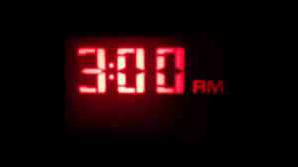


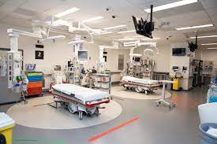
ACS Call

Slide 13
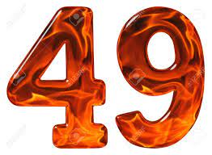
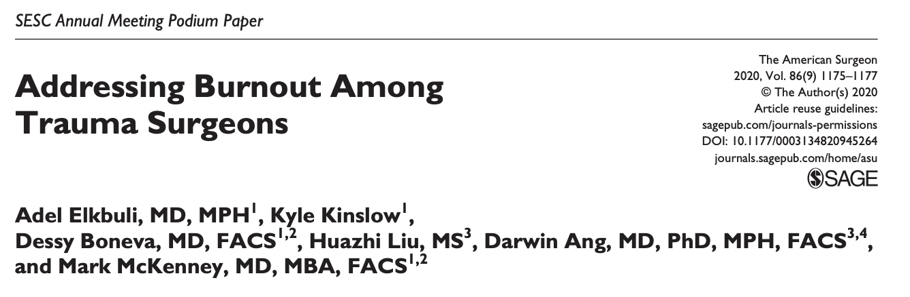
EAST Survey

Slide 14
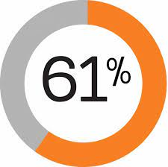
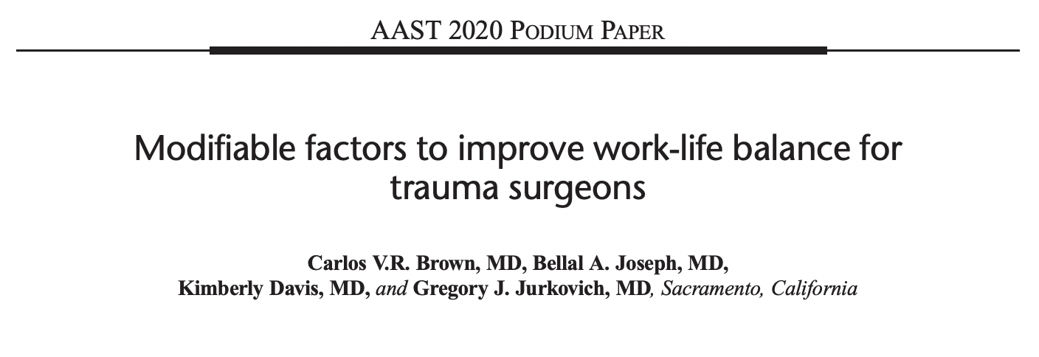
AAST Survey-Work Hours

Slide 15

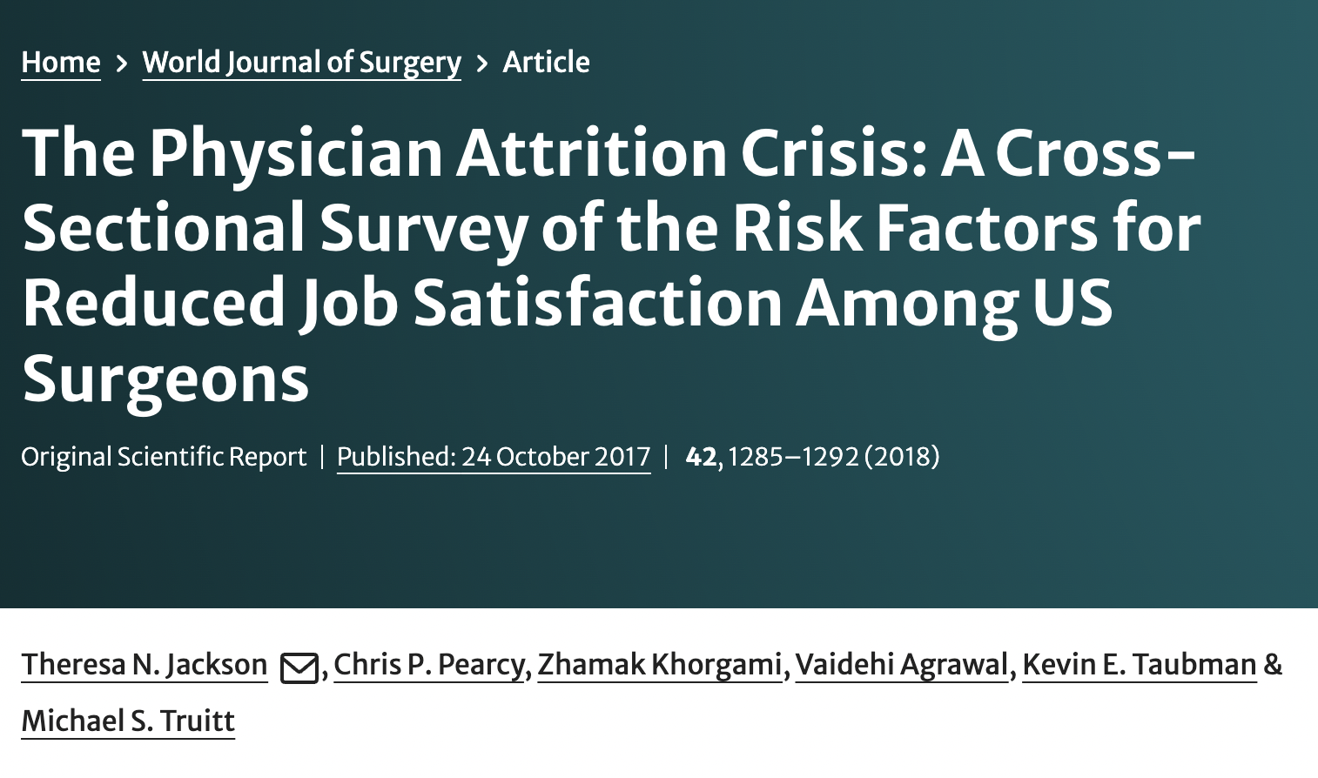
Increasing Work Hours

Slide 16

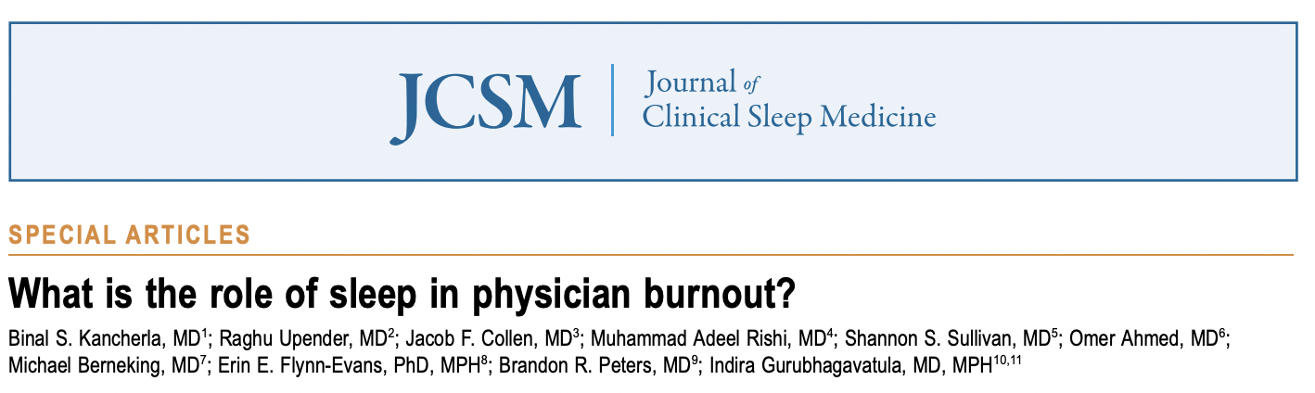
Sleep Deprivation

Slide 17
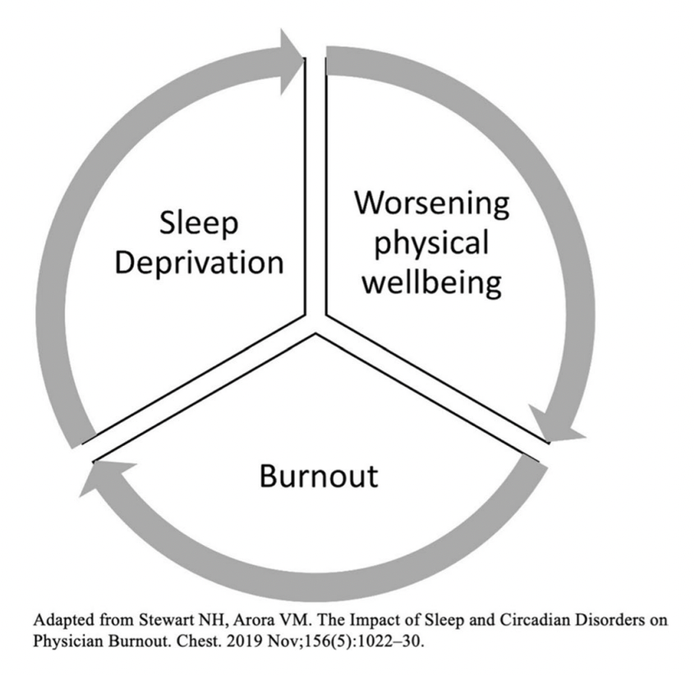
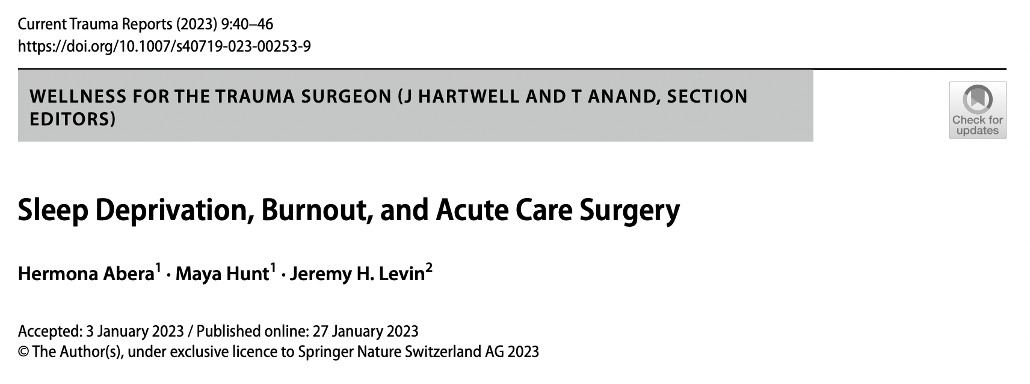
Sleep Deprivation
Depression
Anxiety
Decreased cognition
Apathy
Loss of empathy
Health effects:
  Cardiovascular
  Immunologic
  Metabolic
  Neurocognitive

Slide 18

Sleep Deprivation
Short Term
Long Term
Concentration
Memory
Task performance
Tachycardia
Elevated cortisol
Medical errors (needle sticks)
Higher level cognitive function
Hypertension
Hyperglycemia
Immune suppression
Pregnancy complications
Judgement
Irritability
Substance use disorder
Suicidality
Interpersonal relationship stress
Medical errors

Slide 19
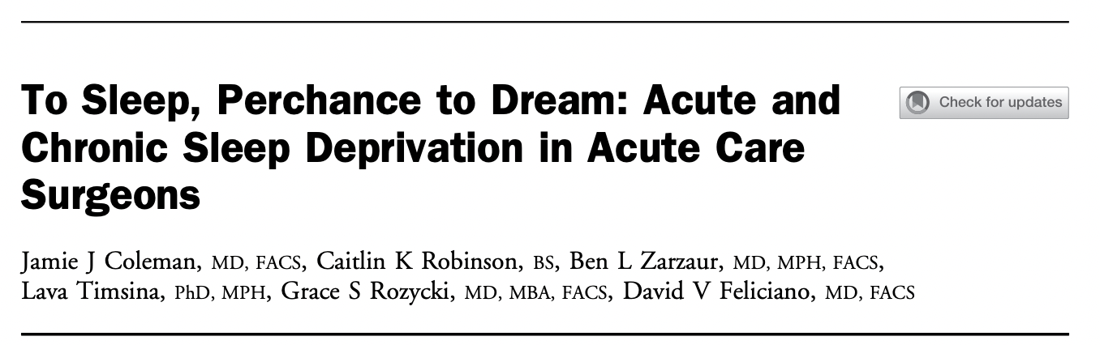
Post-Post Call
64.8% of study population had physiologic evidence of acute or chronic sleep deprivation
Peak disturbances post-call day 2
Return to baseline post-call day 3
“In conclusion, acute care surgeons with in-house call responsibilities commonly exhibit sleep patterns consistent with sleep deprivation.”

Slide 20
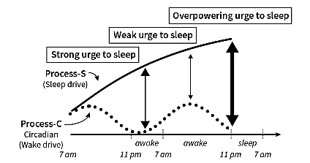
“Why We Sleep” Matthew Walker

Slide 21
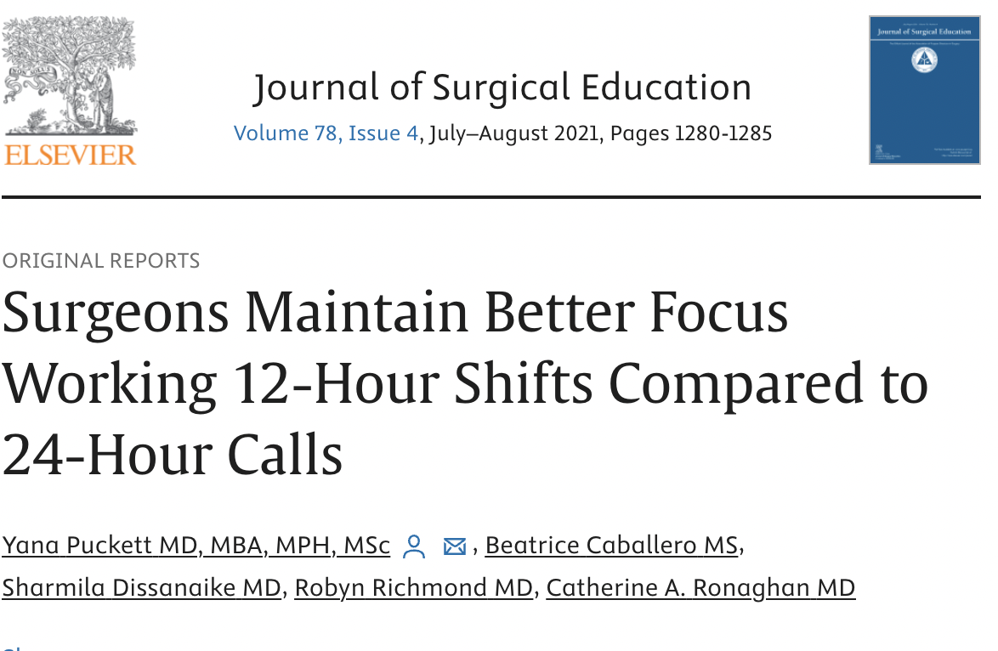
Shift Duration
21 surgeons
61 visual tracking tests
No change in focus in day or night in-house 12 hr shifts
Decrease by 2 “grades” after 24 hr in-house call
Conclusion: Twelve-hour shifts appear to preserve focus in surgeons better compared with 24- hour, in-house calls.

Slide 22

Conclusion
Call schedules that force sleep deprivation put us at risk for:
  Anxiety/depression
  Lack of focus
  Errors
  Burnout
  Untoward health effects
More questions than answers:
  What is the optimal shift duration? 10hr? 12hr? 24hr?
  What is the optimal number of shifts/month?
  Is it ethical to work for 24hr?

