Slide 1



Title of Project
Study Population
Results
Data of outcome
P Value if Present
Conclusions
Data of outcome
P Value if Present
Lead author et al.
<Publication Information>
<Author Twitter Handles>
@EAST_Trauma

Slide 2



Title of Project
Study Population
Results
Conclusions
Lead author et al.
<Publication Information>
<Author Twitter Handles>
@EAST_Trauma

Slide 3


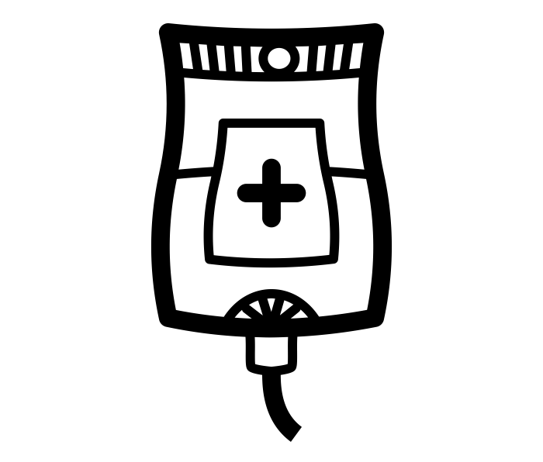
Title of Project
Intervention Group
Outcomes
Control Group
Lead author et al.
<Publication Information>
<Author Twitter Handles>
@EAST_Trauma

Slide 4
Color Scheme for EAST
Background Color
RGB
Red: 255
Green: 227
Blue: 141
Gradient Box
Same color as Background Color,
Gradient with White
Accent Color
RGB
Red: 255
Green: 192
Blue: 0

