Slide 1
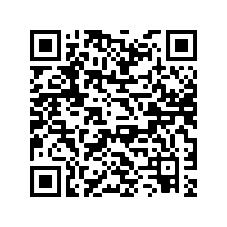


Title
PICO 1
PICO 2
PICO 3
Graphic
Graphic
Graphic
Recommendation
Recommendation
Recommendation
First author et al.
Journal reference.
Twitter handles of authors
Eastern Association for the Surgery of Trauma
Guidelines Committee
Notes:
QR code to the journal article. Can be generated for free at https://www.qr-code-generator.com
Icons from NounProject.com.

Slide 2
Title
PICO 1
PICO 2
Graphic
Graphic
Recommendation
Recommendation
PICO 3
PICO 4
Graphic
Graphic
Recommendation
Recommendation
First author et al.
Journal reference.
Twitter handles of authors
Eastern Association for the Surgery of Trauma
Guidelines Committee
Notes:
QR code to the journal article. Can be generated for free at https://www.qr-code-generator.com
Icons from NounProject.com.

Slide 3
Title
Background
Problem
Diagnosis
Management options
Meta-Analysis
Number of studies
Summary of results
Quality of evidence
Recommend:
Conditionally Recommend:
Recommend Against:
No Recommendation:
First author et al.
Journal reference.
Twitter handles of authors
Eastern Association for the Surgery of Trauma
Guidelines Committee
Notes:
QR code to the journal article. Can be generated for free at https://www.qr-code-generator.com
Icons from NounProject.com.

