Slide 1
Who Reviews Your Grants & Other Sources of Funding Beyond the NIH?
Elliott R. Haut, MD, FACS
Associate Professor of Surgery &
Anesthesiology / Critical Care Medicine &
Emergency Medicine

Slide 2
Goals & Objectives
Review scoring criteria for grants
Suggest alternate funding sources for medical research

Slide 3
Who Reviews Your Grants?

Slide 4
“A Jury of Your Peers”

Slide 5
NIH - Two Levels of Peer Review
In order for the NIH to award research funds, an application must be approved by two levels of NIH peer review.
The two levels of NIH peer review help ensure that the assessment of scientific and technical merit is separate from the funding decision.

Slide 6
First Level of Review (Initial Peer Review)
Assesses scientific and technical merit
Conducted by a Scientific Review Group (SRG)
Composed primarily of non-federal scientists with expertise in relevant scientific disciplines and current research areas
SRG membership public knowledge
You can “pick” your SRG

Slide 7
Second Level of Review (Council Review)
Performed by Institutes and Centers (ICs) National Advisory Councils or Boards
Make recommendations on priority areas of research, pending policy, and funding of particular applications
Composed of both scientific members and public representatives chosen for their expertise, interest, or activity in matters related to health and disease

Slide 8
Core Values of NIH Peer Review
(1) expert assessment
(2) transparency
(3) impartiality
(4) fairness
(5) confidentiality
(6) integrity
(7) efficiency

Slide 9
How Does the Grant Scoring System Work?

Slide 10
NIH Scoring System
Nine-point scoring scale
(1 = highest impact, 9 = lowest impact)
The final impact score is calculated as the average of individual reviewers’ scores, multiplied by 10 (range 10-90)
A percentile is the approximate percentage of applications that received better impact scores than that particular application from the SRG during the past year

Slide 11
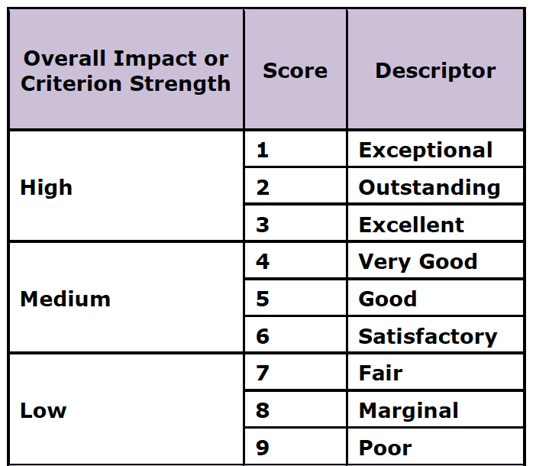
NIH Scoring System

Slide 12
Know the Specific Review Criteria
Federal Agencies transparent about how you will be graded
(NIH, AHRQ, PCORI)
“Study for the test”

Slide 13
NIH Scored Review Criteria ---Research (R01, R03, R21, etc.)
Significance
Investigator(s)
Innovation
Approach
Environment

Slide 14
NIH Scored Review Criteria Career Development (K08, K23, etc.)
Candidate
Career Development Plan/Career Goals & Objectives/Plan to Provide Mentoring
Research Plan
Mentor(s), Co-Mentor(s), Consultant(s), Collaborator(s)
Environment & Institutional Commitment to the candidate

Slide 15
PCORI Review Criteria
Impact of the condition on the health of individuals and populations
Potential for the study to improve health care and outcomes
Technical merit
Patient-centeredness
Patient and stakeholder engagement

Slide 16
More Info on the NIH Grant Review Process
http://grants.nih.gov/grants/PeerReview22713webv2.pdf

Slide 17
Other Sources of Funding Beyond the NIH?

Slide 18
Other Government Agencies
Agency for Healthcare Research and Quality (AHRQ)
Centers for Disease Control and Prevention (CDC)
National Science Foundation (NSF)
Department of Veterans Affairs (VA)
Center for Medicare & Medicaid Services (CMS)
Health Resources & Services Administration (HRSA)
Department of Defense (DoD)

Slide 19
Private Foundations
Howard Hughes Medical Institution
Robert Wood Johnson Foundation
Doris Duke Charitable Foundation
Burroughs Wellcome Fund

Slide 20
Government Funded Private Foundation
Patient Centered Outcomes Research Institute (PCORI)
Independent nonprofit - NOT a federal agency
Authorized by US Congress as part of the Affordable Care Act of 2010
Funded through the Patient-Centered Outcomes Research Trust Fund (PCORTF)
Expected to receive $3.5 billion through 2019

Slide 21
Patient Centered Outcomes Research Institute (PCORI) Mission
“The Patient-Centered Outcomes Research Institute (PCORI) helps people make informed health care decisions, and improves health care delivery and outcomes, by producing and promoting high integrity, evidence-based information that comes from research guided by patients, caregivers and the broader health care community.”
http://www.pcori.org/

Slide 22
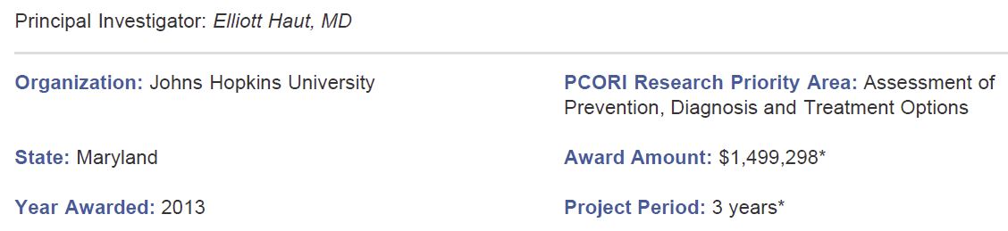
Our PCORI Project
“Preventing Venous Thromboembolism: Empowering Patients and Enabling Patient-Centered Care via Health Information Technology”
http://www.pcori.org/pfaawards/preventing-venous-thromboembolism-empowering-patients-and-enabling-patient-centered-care-via-health-information-technology/

Slide 23
Disease Specific Organizations
American Trauma Society (ATS)
National Trauma Institute (NTI)
American Heart Association (AHA)
American Stroke Association
American Cancer Society (ACS)
American Gastroenterological Association
National Kidney Foundation
Avon Foundation

Slide 24
General Surgical Societies
American College of Surgeons
Association for Academic Surgery
Society of University Surgeons
Association of Women Surgeons
Society of Black Academic Surgeons

Slide 25
Sub-Specialty Surgical Societies
Trauma Surgery Societies
EAST, AAST, WEST
Society for Critical Care Medicine
Society for Vascular Surgery
American Pediatric Surgical Association
Society of Surgical Oncology
American Society of Transplant Surgeons

Slide 26
Private Sector Funding Options (for profit sources)
Pharmaceutical Companies
Medical Device Companies
Insurance Companies
Hospital Systems

Slide 27
Local University Options
Career Development Awards
Centers and/or Institutes
Institutional Research Training Grant (T32)
Clinical and Translational Science Award (CTSA) Programs
KL2 Mentored Clinical Research Scholar Program

Slide 28
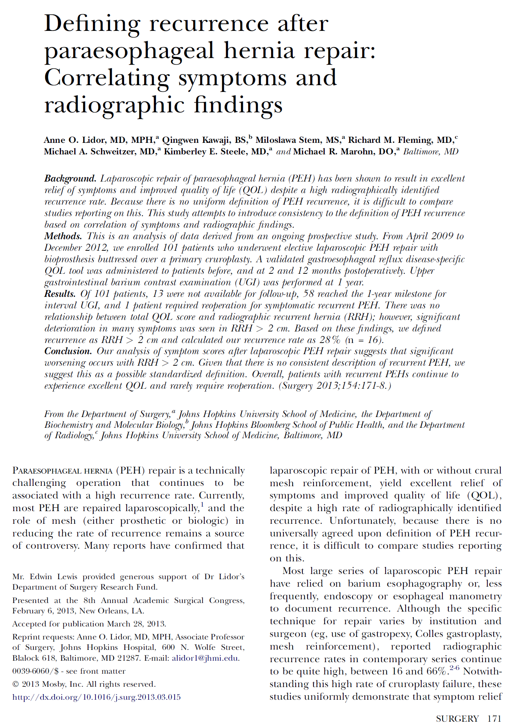
Philanthropic Individual Patients

Slide 29
Alternate Funding Sources

Slide 30
Acknowledgements Grant Funding
(AHRQ) Agency for Healthcare Research and Quality (K08)
“Does Screening Variability Make DVT an Unreliable Quality Measure of Trauma Care?”
(PCORI) Patient-Centered Outcomes Research Institute
“Preventing Venous Thromboembolism: Empowering Patients and Enabling Patient-Centered Care via Health Information Technology”

Slide 31
Recommended Reading
“Funding Opportunities For Outcomes Research”
By Dorry Segev, MD, PhD
In “Success in Academic Surgery: Health Services Research” textbook
Justin Dimick and Caprice Greenberg (Eds.)
Springer (to be published 2014)

Slide 32
Questions?
Elliott R. Haut, MD, FACS
Questions - ehaut1@jhmi.edu
More Info- www.meddium.com/ehaut

